Slide 1


Daniel Eduardo López
July 27, 2022

Slide 2

Outline
Executive Summary
Introduction
Methodology
Results
Conclusion
Appendix

Slide 3
Executive Summary
Summary of methodologies
Summary of all results

Slide 4
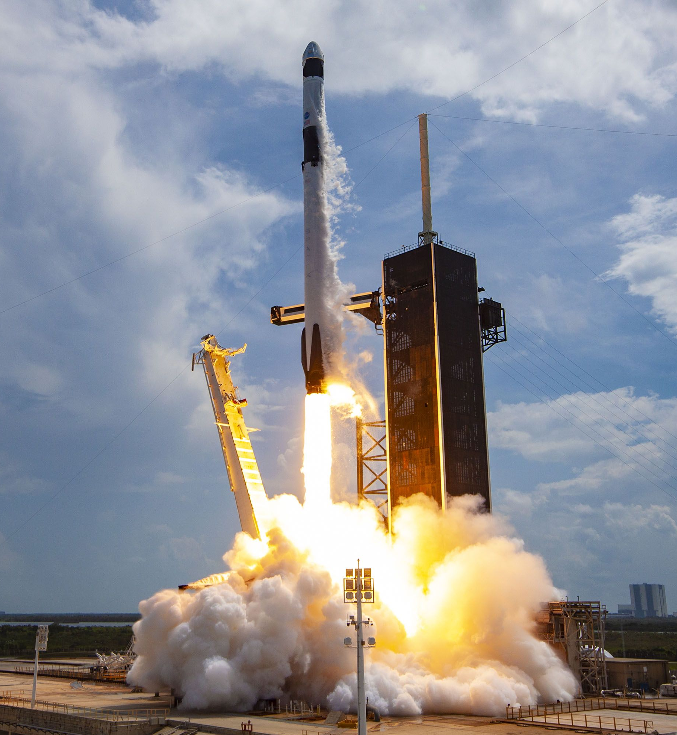
Introduction
SpaceX offers Falcon 9 rocket launches with a cost of 62 million dollars while other providers cost upward of 165 million dollars each. A significant amount of the savings is due to SpaceX's ability to reuse the first stage.
In this context, the main goal of the present study is to predict the first stage landing of the SpaceX Falcon 9 rocket launch by using a classification model in order to determine the cost of a launch.
Furthermore, it is also desirable to obtain other insights from the SpaceX Falcon 9 rocket launches.

Slide 5

Section 1

Slide 6
Methodology
Executive Summary
Python 3 and its libraries were used in the entire project.
First, data was collected through REST calls to the SpaceX API using Requests and by performing web scrapping to the Wikipedia's article on List of Falcon 9 and Falcon Heavy launches using BeatifulSoup. Data covers a time period from 2010-04-06 to 2020-06-12.
Then, a process of data wrangling was performed using Pandas and Numpy in order to filter the data to the Falcon 9 launches only, imputing missing values with the mean, create the landing outcome labels; as well as obtaining dummy variables for the categorical variables.
Next, an exploratory data analysis (EDA) was performed by means of visualization using Matplotlib and SQL.

Slide 7
Methodology
Executive Summary
After that, an interactive visual analysis using Folium and Plotly Dash was carried out.
Finally, a predictive analysis was carried out by means of a Classification Model using Scipy and Scikit-learn. To do so:
Data was split in a training and test sets.
The model was built by using several machine learning techniques: Logistic Regression, Support Vector Machines (SVM), Decision Trees and K-Nearest Neighbors (KNN).
The models were tuned by using GridSearchCV, in which several parameters were tested, and the data was cross-validated in a 10-fold scheme.
The best model was selected based on the criteria of outcome of the confusion matrix, precision, recall, f1-score, accuracy and easiness to calculate landing probabilities.

Slide 8
Data Collection
Data sets were collected through SpaceX API and Web Scrapping in Python 3 by using the libraries Requests, Pandas, Numpy, BeautifulSoup, among others.
SpaceX API
Web Scrapping
Data sets

Slide 9
Data Collection – SpaceX API
The purpose of this step was to make a get request to the SpaceX API and clean the requested data.
Link of the data source:
https://cf-courses-data.s3.us.cloud-object-storage.appdomain.cloud/IBM-DS0321EN-SkillsNetwork/datasets/API_call_spacex_api.json
GitHub URL:
https://github.com/DanielEduardoLopez/IBM-SpaceX/blob/main/1-Spacex-data-collection-api.ipynb
Set URL and GET Request
Response Decoding
Data Combination and Conversion to Dataframe
Functions Definition and API calls
Filtering (Falcon 9 only)
Missing Values Imputing (mean)

Slide 10
Data Collection - Scraping
The purpose of this step was to extract the Falcon 9 launch records from Wikipedia.
Link of the data source:
https://en.wikipedia.org/wiki/List_of_Falcon\_9\_and_Falcon_Heavy_launches
GitHub URL:
https://github.com/DanielEduardoLopez/IBM-SpaceX/blob/main/2-Webscraping.ipynb
Set URL and GET Request
BeautifulSoup Object Creation
HTML Tables Parsing
Conversion to Pandas Dataframe

Slide 11
Data Wrangling
Column Types Identification
Missing Values Identification
Number of Launches per Site
Number and occurrence of each orbit
Number and occurence of mission outcome per orbit type
Landing Outcome Label Creation
The purpose of this step was to find some patterns in the data and determine the label for training supervised models.
GitHub URL:
https://github.com/DanielEduardoLopez/IBM-SpaceX/blob/main/3-Spacex_Data_wrangling.ipynb

Slide 12
EDA with Data Visualization
The purpose of this step was to perform Exploratory Data Analysis with Pandas and Matplotlib. The following charts were plotted:
Scatter Plot of "Flight Number" vs. "Payload Mass": To assess the likelihood of the first stage return in function of the Payload Mass and the Flight Number.
Scatter Plot of "Flight Number" vs. "Launch Site": To assess the relationship among Launch Site, Flight Number, and the first stage return.
Scatter Plot of "Payload Mass" vs. "Launch Site": To assess the relationship among Launch Site, Payload Mass and the first stage return.
Bar chart of the "Orbit" "Success Rate": To assess the sucess rate of each orbit.
Scatter Plot of "Flight Number" vs. "Orbit": To assess the relationship among Flight Number, Orbit, and the first stage return.
Scatter Plot of "Payload Mass" vs. "Orbit": To assess the relationship among Payload Mass, Orbit, and the first stage return.
Line Chart of "Payload Mass" vs. "Orbit": To visualize the launch success yearly trend.
GitHub URL: https://github.com/DanielEduardoLopez/IBM-SpaceX/blob/main/5-EDA_dataviz.ipynb

Slide 13
Feature Engineering
In addition, Feature Engineering was carried out to select the features that were used in the classification model. The following ones were selected:
'FlightNumber', 'PayloadMass', 'Orbit', 'LaunchSite', 'Flights', 'GridFins', 'Reused', 'Legs', 'LandingPad', 'Block', 'ReusedCount', 'Serial'
Then, dummy variables were created for the categorical variables Orbits, LaunchSite, LandingPad, and Serial using the get_dummies() function.
Finally, the whole dataset was casted to float64 datatype.
GitHub URL: https://github.com/DanielEduardoLopez/IBM-SpaceX/blob/main/5-EDA_dataviz.ipynb

Slide 14
EDA with SQL
Furthermore, the following SQL queries were performed after loading the dataset into a corresponding table in a database using the libraries Sqlite3 and Sqlalchemy:
SELECT Launch_Site, COUNT(Launch_Site) AS Count FROM SPACEXTBL GROUP BY Launch_Site;
SELECT * FROM SPACEXTBL WHERE Launch_Site LIKE 'CCA%' LIMIT 5;
SELECT SUM(PAYLOAD_MASS__KG_) FROM SPACEXTBL WHERE Customer = 'NASA (CRS)';
SELECT AVG(PAYLOAD_MASS__KG_) FROM SPACEXTBL WHERE Booster_Version LIKE 'F9 v1.1%';
SELECT MIN(Date) FROM SPACEXTBL WHERE "Landing _Outcome" = 'Success (ground pad)';

Slide 15
EDA with SQL
SELECT Booster_Version FROM SPACEXTBL WHERE "Landing _Outcome" = 'Success (drone ship)' AND PAYLOAD_MASS__KG_ > 4000 AND PAYLOAD_MASS__KG_ < 6000;
SELECT Mission_Outcome, COUNT(Payload) FROM SPACEXTBL GROUP BY Mission_Outcome;
SELECT Booster_Version FROM SPACEXTBL WHERE PAYLOAD_MASS__KG_ = (SELECT MAX(PAYLOAD_MASS__KG_) FROM SPACEXTBL);
SELECT SUBSTR(Date,1,4) AS Year, COUNT("Landing _Outcome") AS Successful_landing_outcomes FROM SPACEXTBL WHERE DATE > '2010-06-04' AND DATE < '2017-03-20' AND "Landing _Outcome" LIKE 'Success%' GROUP BY SUBSTR(Date,1,4) ORDER BY SUBSTR(Date,1,4) DESC;

Slide 16
EDA with SQL
SELECT DISTINCT (CASE when SUBSTR(Date, 6, 2) = '01' then 'January' when SUBSTR(Date, 6, 2) = '02' then 'February' when SUBSTR(Date, 6, 2) = '03' then 'March' when SUBSTR(Date, 6, 2) = '04' then 'April' when SUBSTR(Date, 6, 2) = '05' then 'May' when SUBSTR(Date, 6, 2) = '06' then 'June' when SUBSTR(Date, 6, 2) = '07' then 'July' when SUBSTR(Date, 6, 2) = '08' then 'August' when SUBSTR(Date, 6, 2) = '09' then 'September' when SUBSTR(Date, 6, 2) = '10' then 'October' when SUBSTR(Date, 6, 2) = '11' then 'November' when SUBSTR(Date, 6, 2) = '12' then 'December' END) AS Month, "Landing _Outcome", Booster_Version, Launch_Site FROM SPACEXTBL WHERE SUBSTR(Date,1,4)='2015' AND "Landing _Outcome" = 'Failure (drone ship)’;
GitHub URL: https://github.com/DanielEduardoLopez/IBM-SpaceX/blob/main/4-EDA_sql_sqllite.ipynb

Slide 17
Build an Interactive Map with Folium
An Interactive Map with the Folium library was created, and the following maps objects were created and added to the map:
Markers and circles for all launch sites: To visualize the location of the launch sites and assess their characteristics.
Marker Clusters for success/failed launches for each site: To assess if there was a relationship among the launch sites and their success/fail missions.
Markers and lines between a launch site to its proximities: To assess the characteristics of the proximities to the launch sites.
GitHub URL: https://github.com/DanielEduardoLopez/IBM-SpaceX/blob/main/6-Folium_Launch_site_location.ipynb

Slide 18
Build a Dashboard with Plotly Dash
An Interactive Dashboard with the Plotly and Dash libraries was built, and the following plots/graphs and interactions were added to the dashboard:
Dropdown: In order to enable the Launch Site selection for the user.
Pie chart: To show the Total Success Launches by Site.
Range Slider: To enable the Payload Mass selection.
Scatter Plot: To show the relationship among Payload Mass and mission outcomes for the selected Sites.
GitHub URL:
https://github.com/DanielEduardoLopez/IBM-SpaceX/blob/main/7-spacex_dash_app.py
https://github.com/DanielEduardoLopez/IBM-SpaceX/blob/main/8-SpaceX_Dashboard.ipynb

Slide 19
Predictive Analysis (Classification)
Data Standarization (Standard Scaler)
Creation of logistic regression, SVM, decision tree and KNN objects.
Dataset split into training and test data.
Accuracy calculation (score method)
Plot of confusion matrix
Identification of best parameters with GridSearchCV.
Selection of best classification model with classificaction report.
The purpose of this step was to build a Classification model for predicting the landing of the first phase; as well as finding the best hyperparameters and the best model.
GitHub URL: https://github.com/DanielEduardoLopez/IBM-SpaceX/blob/main/9-SpaceX_Machine%20Learning%20Prediction.ipynb

Slide 20
Results
Exploratory data analysis results
Orbit | Count | Success Rate
GTO | 27 | 51.85%
ISS | 21 | 61.90%
VLEO | 14 | 85.71%
PO | 9 | 66.67%
LEO | 7 | 71.43%
SSO | 5 | 100.00%
MEO | 3 | 66.67%
ES-L1 | 1 | 100.00%
HEO | 1 | 100.00%
SO | 1 | 0.00%
GEO | 1 | 100.00%
Launch Site | Count | Success Rate
CCAFS SLC 40 | 55 | 60.00%
KSC LC 39A | 22 | 77.27%
VAFB SLC 4E | 13 | 76.92%
Year | Successful Landing Outcomes
2017 | 4
2016 | 5
2015 | 1

Slide 21
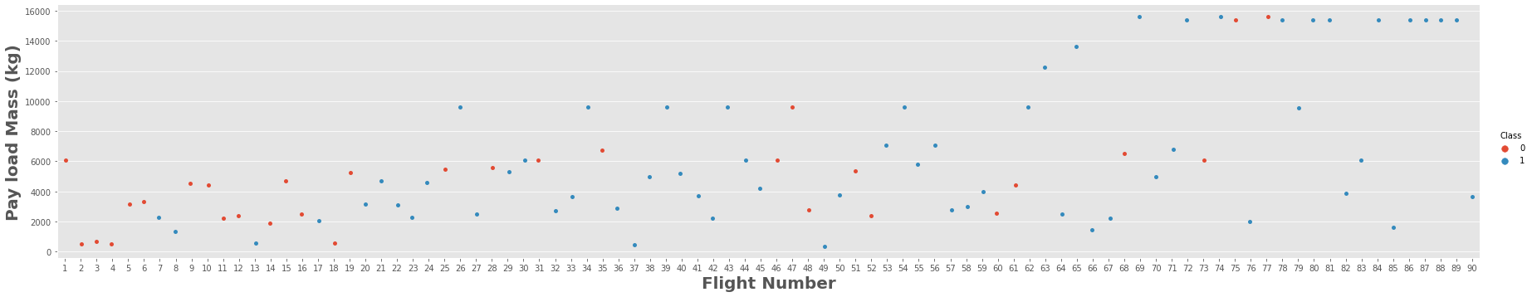
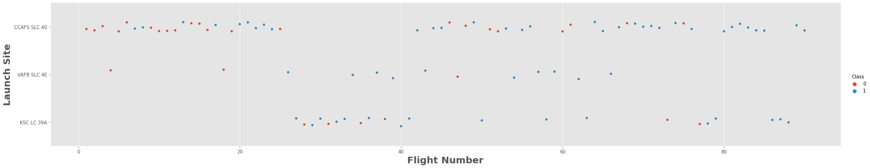
Results
Exploratory data analysis results

Slide 22
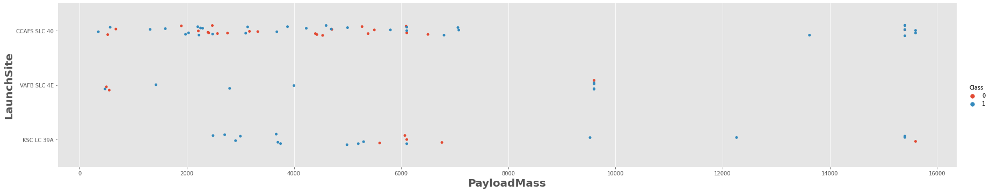
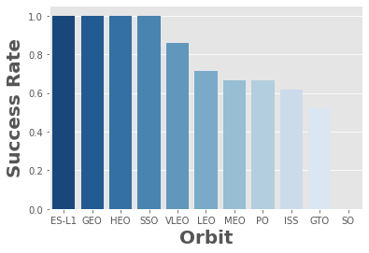
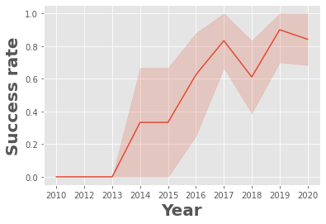
Results
Exploratory data analysis results

Slide 23
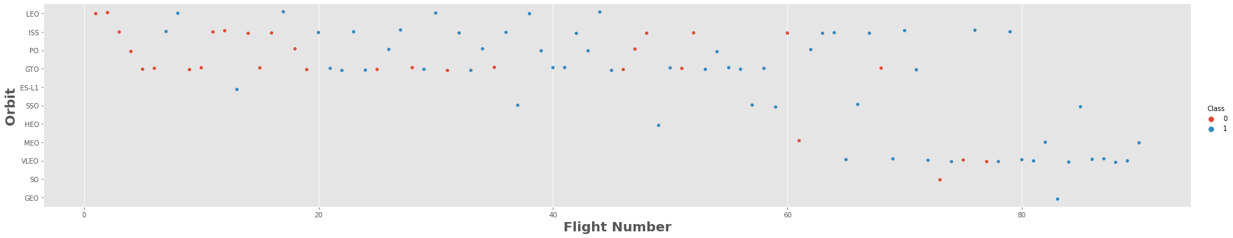
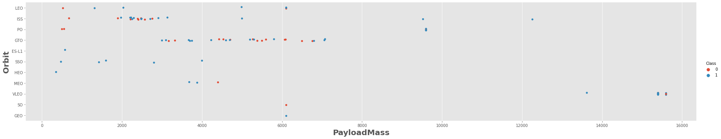
Results
Exploratory data analysis results

Slide 24
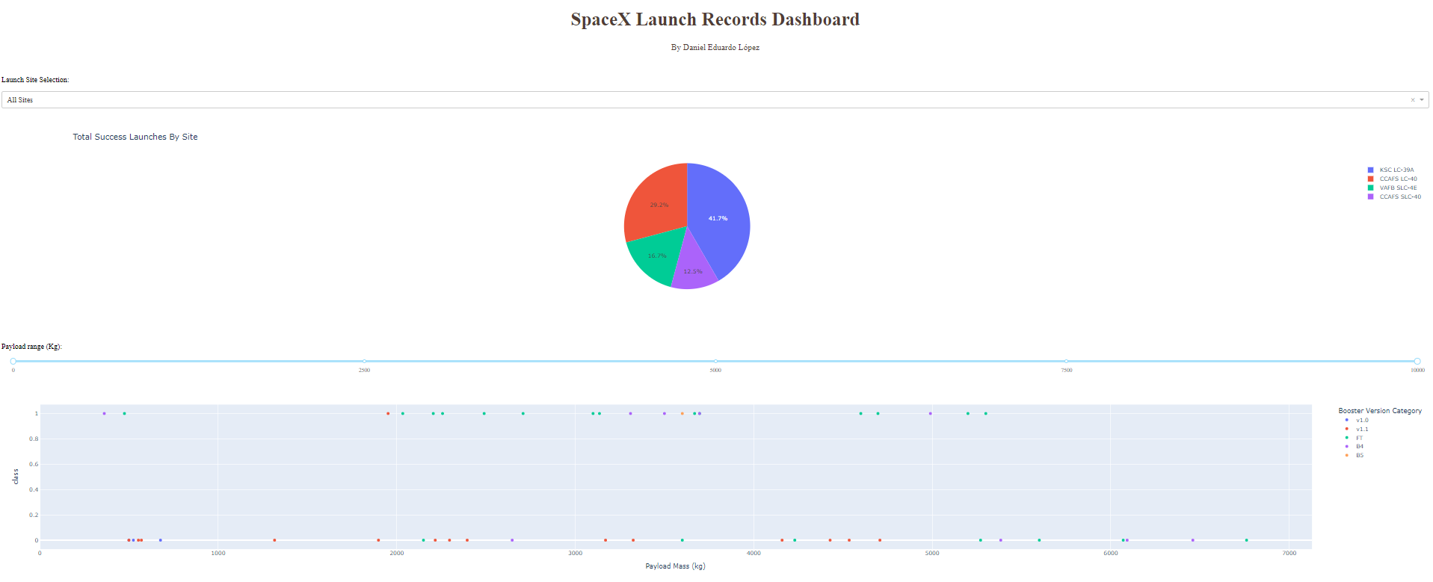
Results
Interactive analytics demo.

Slide 25
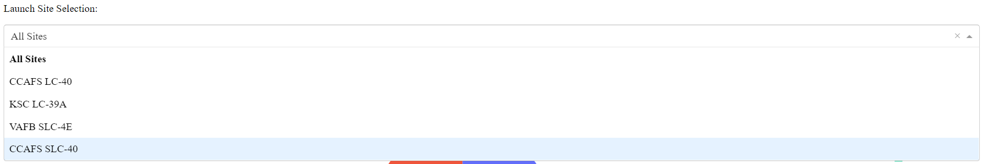
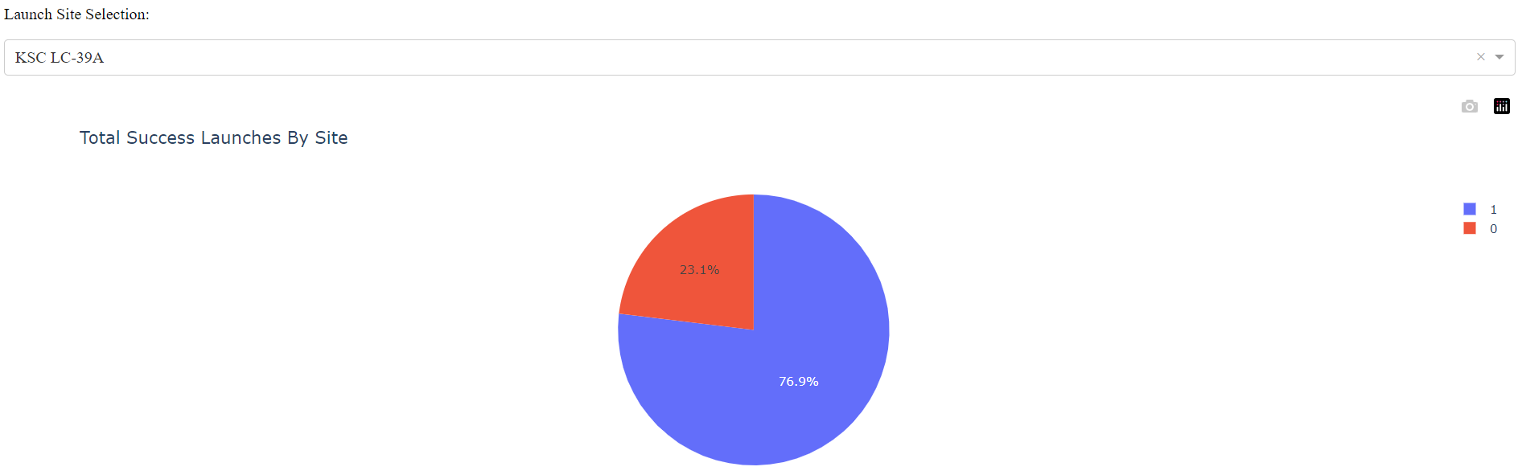
Results
Interactive analytics demo.

Slide 26
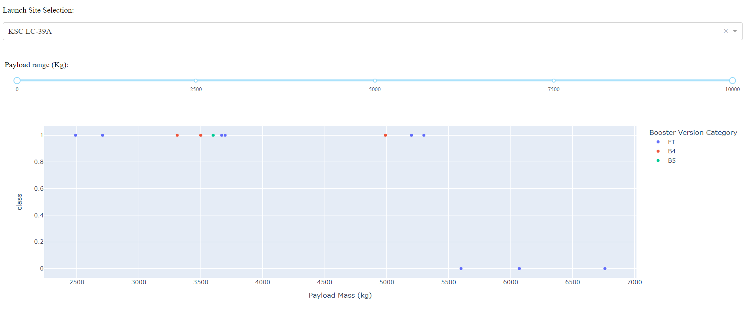
Results
Interactive analytics demo.

Slide 27
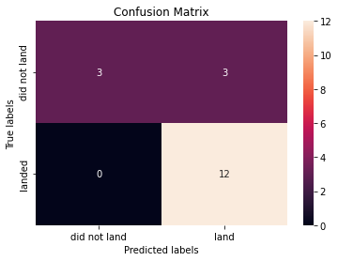
Results
Predictive analysis results
Logistic regression confusion matrix.
SVM confusion matrix.

Slide 28
Results
Predictive analysis results
Decision trees confusion matrix.
KNN confusion matrix.

Slide 29
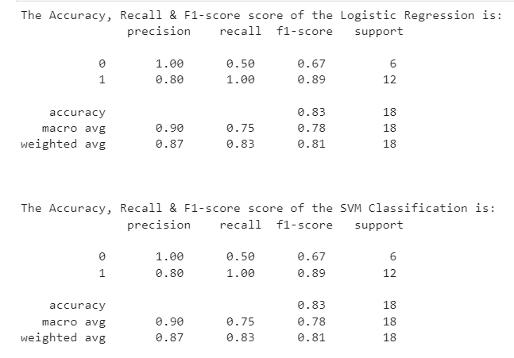
Results
Predictive analysis results

Slide 30
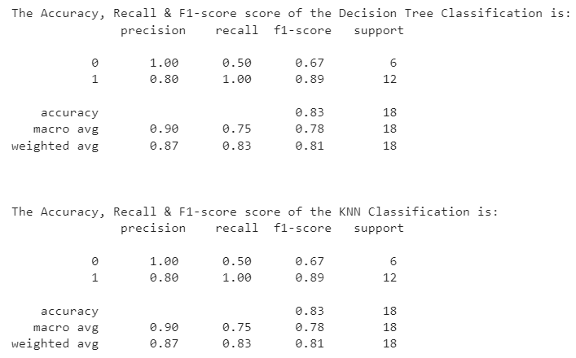
Results
Predictive analysis results

Slide 31

Section 2

Slide 32
Flight Number vs. Launch Site
CCAFS SLC 40 is the most used Launch Site and the VAFB SLC-4E is the least used.
The success rate has improved over the years as represented by the Flight number.
KSC LC-39A is the launch site with the highest number of successful missions.

Slide 33
Payload vs. Launch Site
CCAFS SLC 40 and KSC LC-39A are used for a broad range of Payload masses, from light to extra heavy payloads.
VAFB SLC-4E is only used for light and medium payloads, which might explain why is the less used launch site.
The missions tend to be more successful with heavier payloads.

Slide 34
Success Rate vs. Orbit Type
ES-L1, GEO, HEO and SSO are the orbit types with the highest success rates (100%).
SO is the orbit type with the lowest success rate (0%).
The rest of the orbit types have a success rate ranging from 50% to 85%.

Slide 35
Flight Number vs. Orbit Type
LEO, ISS, PO, GTO and VLEO are the most common orbit types.
EO, PO, GTO and VLEO are less common in recent flight numbers.
VLEO is the most common orbit type in recent flight numbers.
Earlier flight numbers show a tendency to fail regardless of the orbit type.

Slide 36
Payload vs. Orbit Type
Heavier payloads are selected for VLEO, IS and PO orbit types and have a high rate of success.
It appears that ES-L1, SSO and HEO are used with light payloads (from 0 to 4000 kg) and have a high rate of success.
The rest of the orbit types are used with light and medium payloads (from 0 to 7000 kg).

Slide 37
Launch Success Yearly Trend
Definitely, the launch success rate have improved over the years.
In particular, the success rate have improved since 2013, from 0% to an 80% in 2017.
Since 2017, it appears that the success rate has stabilized in about 80%.

Slide 38
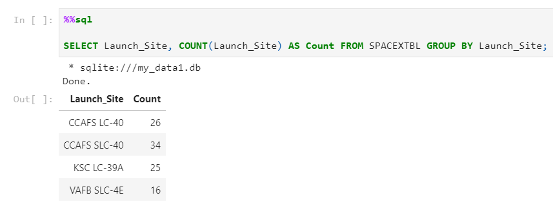
All Launch Site Names
CCAFS SLC-40 is the most used Launch Site and the .

Slide 39
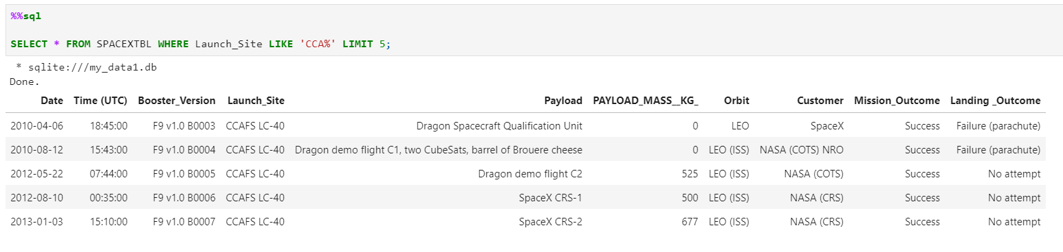
Launch Site Names Begin with 'CCA'
The launch site whose name begins with the string 'CCA' is CCAFS SLC-40.

Slide 40
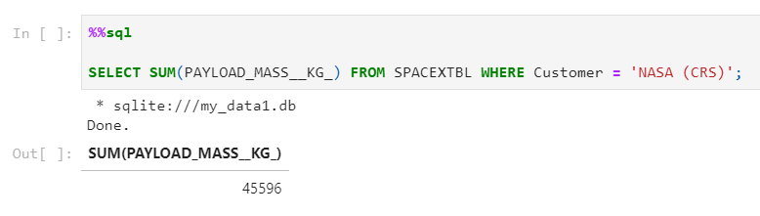
Total Payload Mass
The total payload carried by boosters from NASA is 45 596 kg.

Slide 41
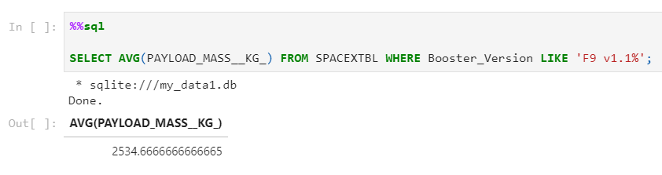
Average Payload Mass by F9 v1.1
The average payload mass carried by booster version F9 v1.1 is 2534.66 kg, which is in the range of the light payloads.

Slide 42
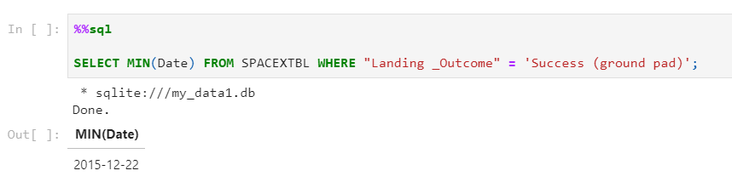
First Successful Ground Landing Date
The first successful landing outcome on ground pad was achieved on 2015-12-22.

Slide 43
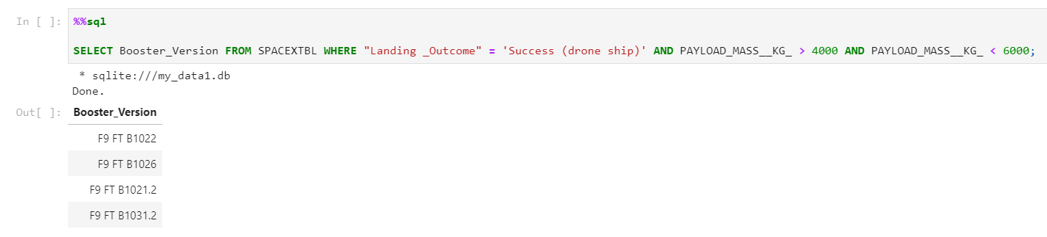
Successful Drone Ship Landing with Payload between 4000 and 6000
The names of boosters which have successfully landed on drone ship and had payload mass greater than 4000 but less than 6000 are F9 FT B1022, F9 FT B1026, F9 FT B1021.2 and F9 FT B1031.2.

Slide 44
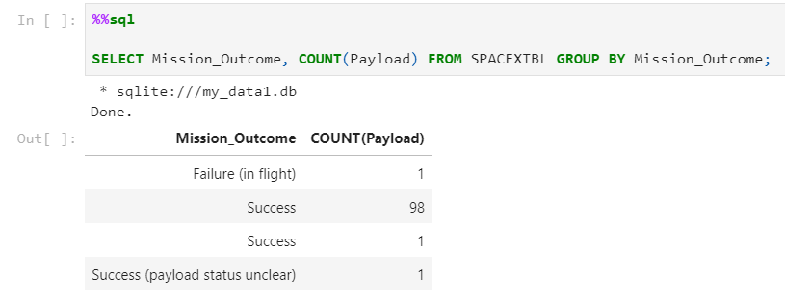
Total Number of Successful and Failure Mission Outcomes
The total number of successful and failure mission outcomes are 100 and 1, respectively.

Slide 45
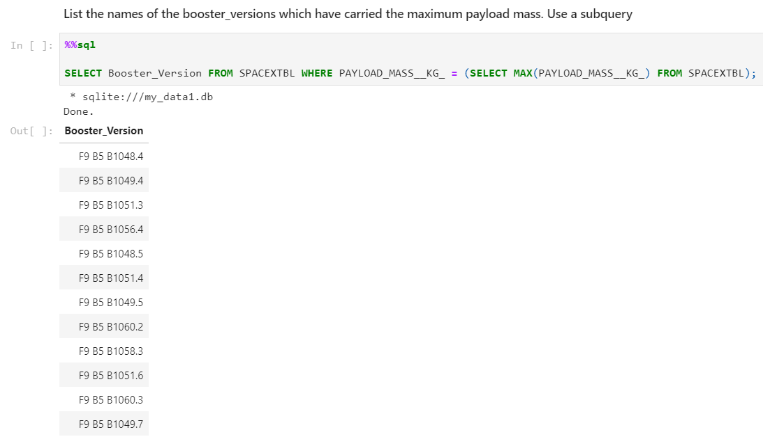
Boosters Carried Maximum Payload
The names of the booster which have carried the maximum payload mass are shown in the image below:

Slide 46
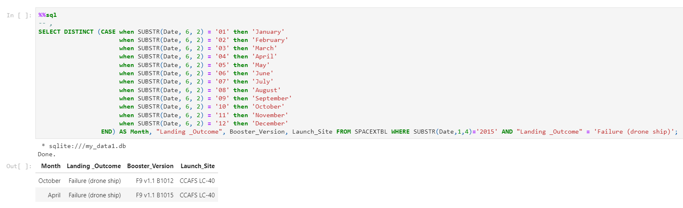
2015 Launch Records
The failed landing_outcomes in drone ship, their booster versions, and launch site names for in year 2015 happened in October and April.

Slide 47
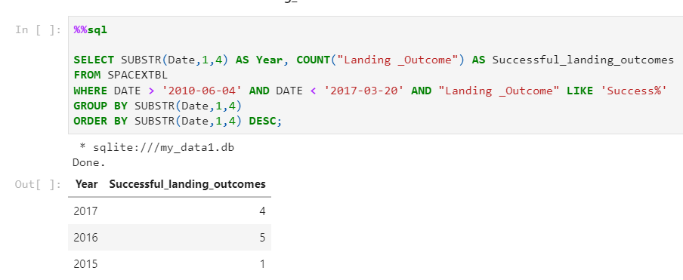
Rank Landing Outcomes Between 2010-06-04 and 2017-03-20
The rank of count of landing outcomes (such as Failure (drone ship) or Success (ground pad)) between the date 2010-06-04 and 2017-03-20, in descending order is shown in the email below:

Slide 48

Section 3

Slide 49
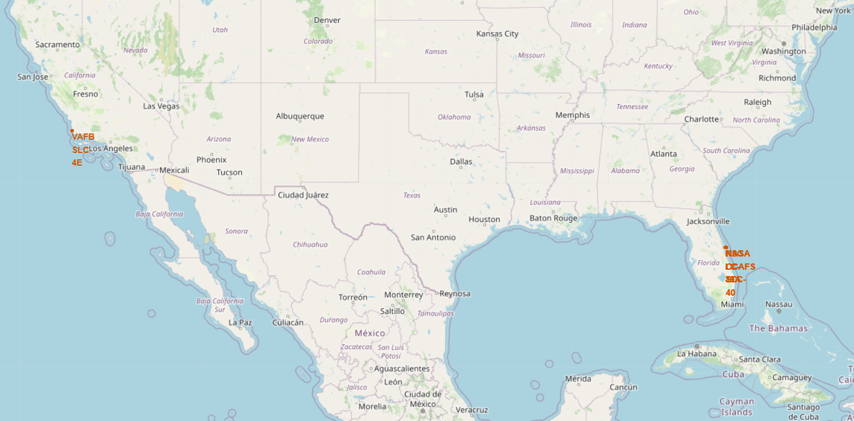
Launch Sites Localization
Launch sites are located on the coasts and close to the Ecuador.

Slide 50
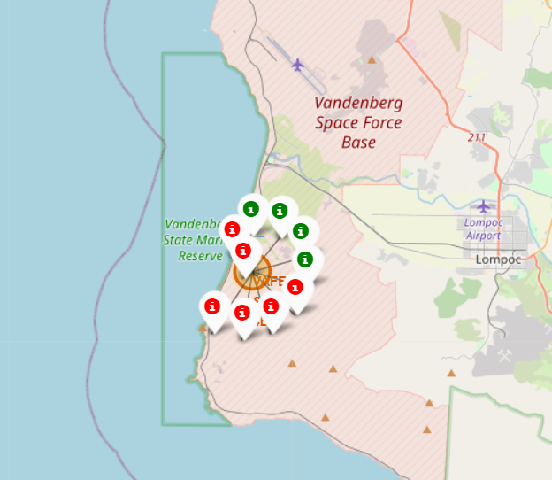
Launch Outcomes Per Launch Site
The Vanderberg (VAFB SLC-4E) Launch Site is the least used and its number of successful landings is fairly low.

Slide 51
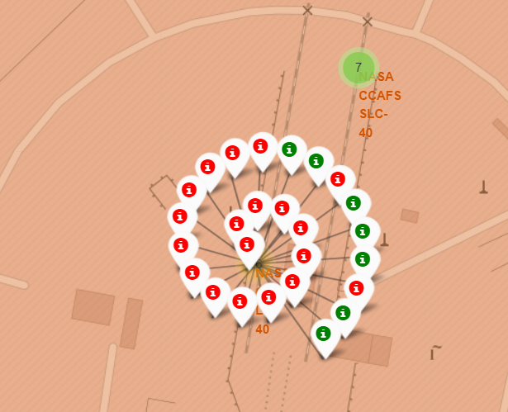
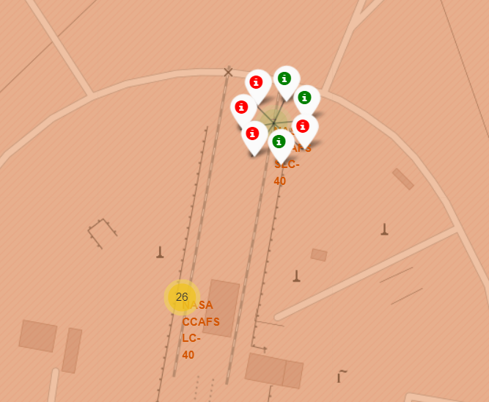
Launch Outcomes Per Launch Site
The Cape Canaveral (CCAFS LC-40 and CCAFS SLC-40) is the most used Launch Site even though its number of failed landings is slightly superior to the its number of successful landings.

Slide 52
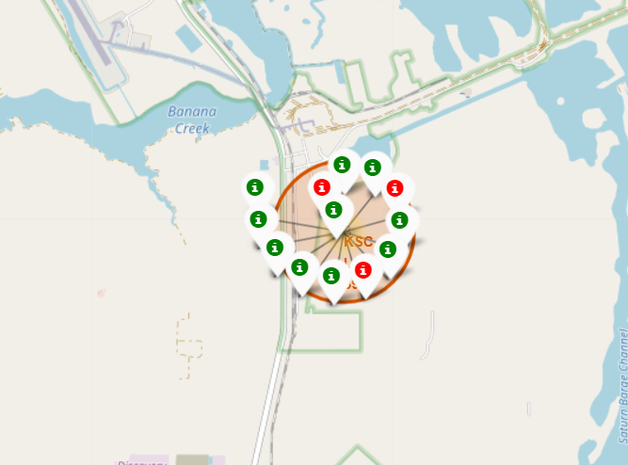
Launch Outcomes Per Launch Site
The Kennedy Space Center (KSC LC-39A) has the highest number of successful missions. Nonetheless, it is not the most used Launch Site.

Slide 53
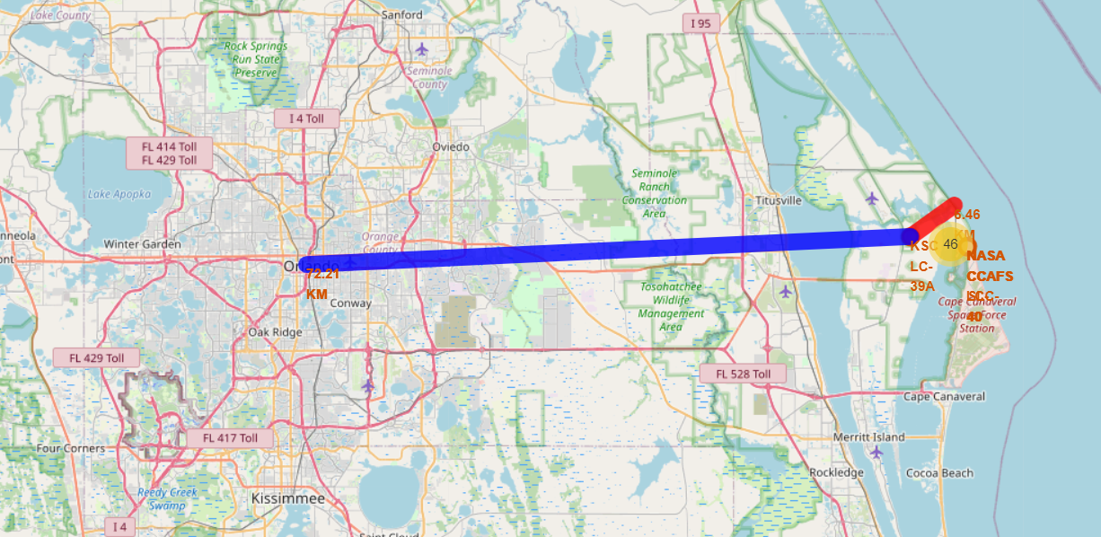
KSC LC-39A distance to the sea and Orlando, FL.
KSC LC-39A is 6.46 KM far from the Atlantic Sea, and 72.21 KM far from Orlando, FL.

Slide 54

Section 4

Slide 55
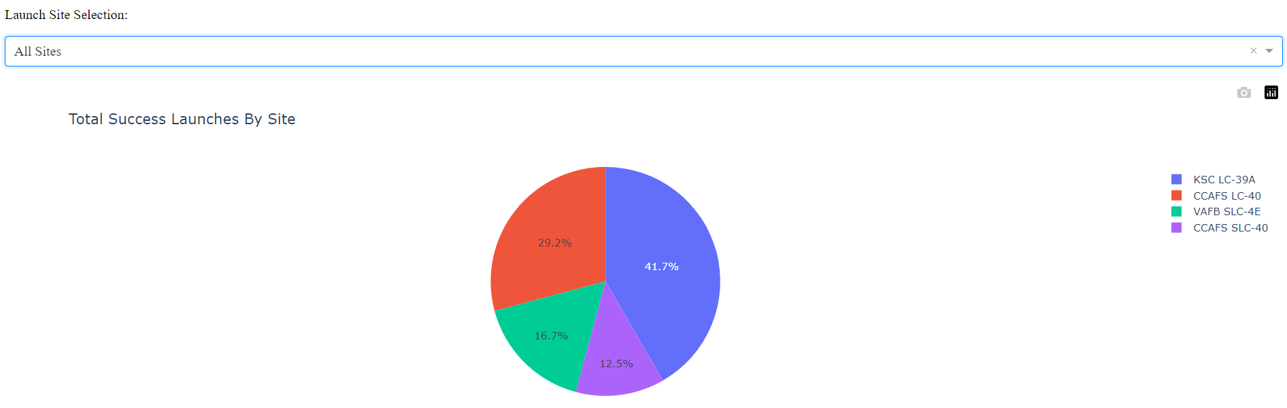
Launch Success Per Site
KSC LC-39A has the highest success launch rates, while VAFB SLC-4E holds the lowest. It is important to note that CCAFS LC-40 and CCAFS SLC-40 refer to the same facility.

Slide 56
Highest Launch Success Ratio
The Highest Launch Success Ratio is hold by the KSC LC-39A launch site, with a 76.9% of success and only 23.1% of failure.

Slide 57
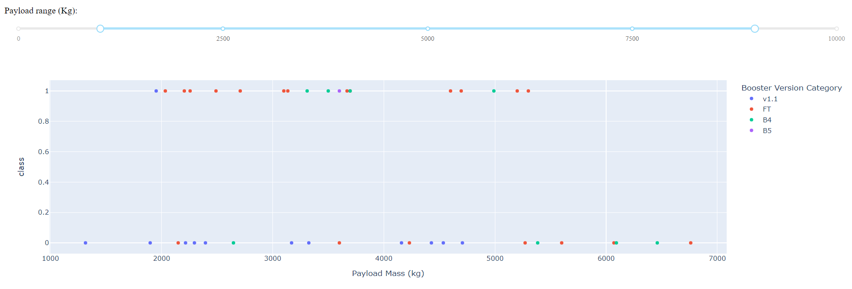
Payload vs. Launch Outcome
The Payload vs. Launch Outcome allowed to identify the payload ranges with the highest and the lowest success rates as well as the more successful F9 Booster versions.

Slide 58
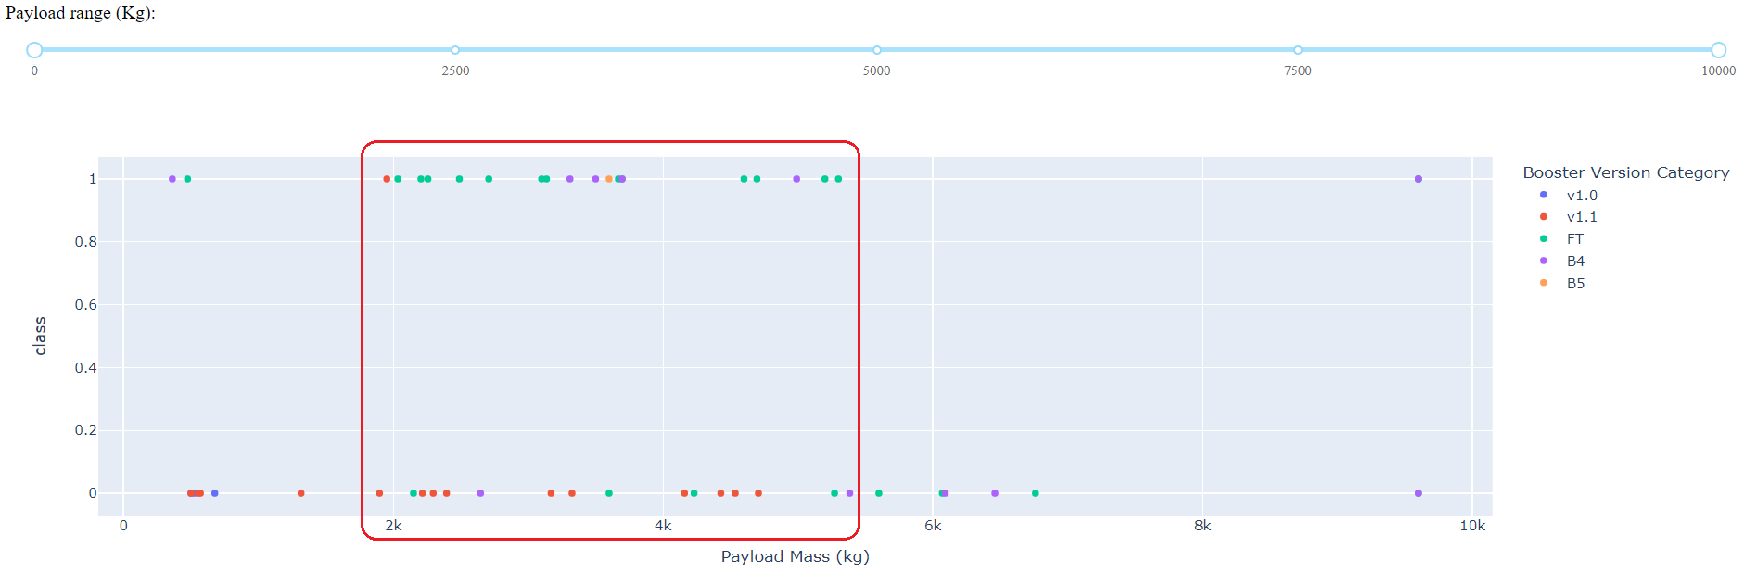
Payload vs. Launch Outcome
Which payload range(s) has the highest launch success rate? From 1952 kg to 5300 kg.

Slide 59
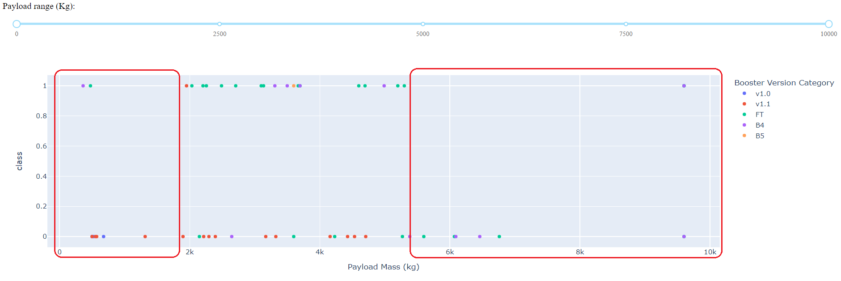
Payload vs. Launch Outcome
Which payload range(s) has the lowest launch success rate? Below 1952 kg and above 5300 kg.

Slide 60
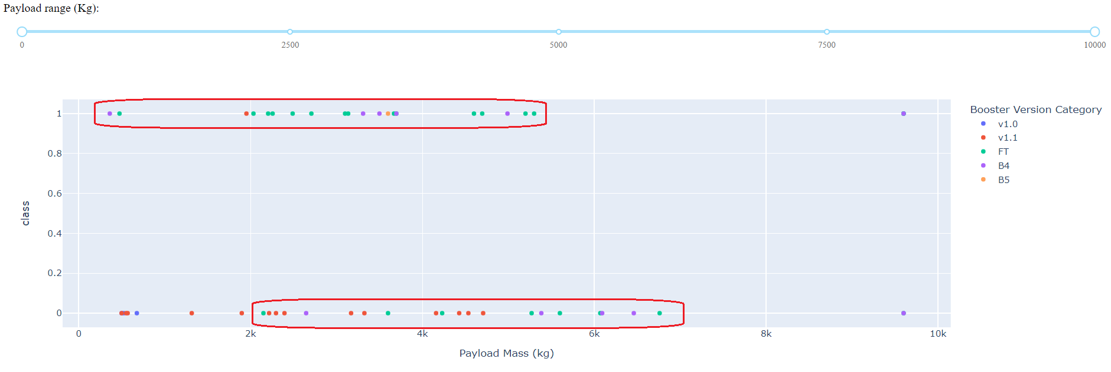
Best Booster versions
Which F9 Booster version (v1.0, v1.1, FT, B4, B5, etc.) has the highest launch success rate? The FT and the B5 Booster versions.

Slide 61

Section 5

Slide 62
Classification Accuracy
Visualize the built model accuracy for all built classification models, in a bar chart
Find which model has the highest classification accuracy

Slide 63
Confusion Matrix
The confusion matrix suggests that the built model is better at predicting unsuccessful landings than successful landings.
So, there is room for improvement in terms of reducing false positives.

Slide 64
Conclusions
Point 1
Point 2
Point 3
Point 4
…

Slide 65
Appendix
Dataset used in the building of the Classification Model:
FlightNumber | PayloadMass | Flights | GridFins | Reused | Legs | Block | ReusedCount | Orbit_ES-L1 | Orbit_GEO | Orbit_GTO | Orbit_HEO | Orbit_ISS | Orbit_LEO | Orbit_MEO | ...
1 | 6104.959 | 1 | 0 | 0 | 0 | 1 | 0 | 0 | 0 | 0 | 0 | 0 | 1 | 0 | ...
2 | 525 | 1 | 0 | 0 | 0 | 1 | 0 | 0 | 0 | 0 | 0 | 0 | 1 | 0 | ...
3 | 677 | 1 | 0 | 0 | 0 | 1 | 0 | 0 | 0 | 0 | 0 | 1 | 0 | 0 | ...
4 | 500 | 1 | 0 | 0 | 0 | 1 | 0 | 0 | 0 | 0 | 0 | 0 | 0 | 0 | ...
5 | 3170 | 1 | 0 | 0 | 0 | 1 | 0 | 0 | 0 | 1 | 0 | 0 | 0 | 0 | ...
6 | 3325 | 1 | 0 | 0 | 0 | 1 | 0 | 0 | 0 | 1 | 0 | 0 | 0 | 0 | ...
7 | 2296 | 1 | 0 | 0 | 1 | 1 | 0 | 0 | 0 | 0 | 0 | 1 | 0 | 0 | ...
8 | 1316 | 1 | 0 | 0 | 1 | 1 | 0 | 0 | 0 | 0 | 0 | 0 | 1 | 0 | ...
9 | 4535 | 1 | 0 | 0 | 0 | 1 | 0 | 0 | 0 | 1 | 0 | 0 | 0 | 0 | ...
10 | 4428 | 1 | 0 | 0 | 0 | 1 | 0 | 0 | 0 | 1 | 0 | 0 | 0 | 0 | ...
11 | 2216 | 1 | 0 | 0 | 0 | 1 | 0 | 0 | 0 | 0 | 0 | 1 | 0 | 0 | ...
12 | 2395 | 1 | 1 | 0 | 1 | 1 | 0 | 0 | 0 | 0 | 0 | 1 | 0 | 0 | ...
... | ... | ... | ... | ... | ... | ... | ... | ... | … | ... | ... | ... | … | ... | ...

Slide 66


